Slide 1

CROSSROADS CLASSIC
ANALYTICS CHALLENGE ‘25
TEAM: DATA CURRY

Slide 2







MEET
THE
TEAM
Ajay Shankar
Rohan
Krithiga Rajan
Subbaiah
Keerthi Anand

Slide 3
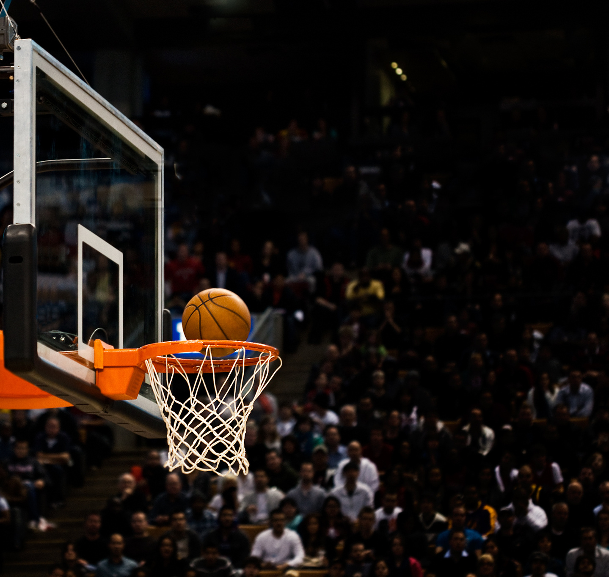



Problem Statement
What?
Analyze school affinity and other institution based feautures’ impact on a customers March Madness predictions.
Why?
Understand patterns and biases in predictions to refine models and understand more about the customer preferences.
How?
Build predictive models and visuals using bracket entry data, external sources, and Tableau.

Slide 4


How does the data look?
Bracket Entry Dataset
NCAA Institution dataset
130,002 rows
17 columns
68 rows
20 Columns
Has bracket entry predictions of customers and their postal codes, latitudes & longitudes
Has 68 institutes’ data, including wins, losses average score, attendance enrollment etc.
Consolidated data set
Has 130,002 rows
135 columns
Consolidated daset after joining the above 2 dataset using 4 region IDs

Slide 5
Exploratory Data Analysis in Tableau

Slide 6
Now Let’s talk about the Model

Slide 7


Model Strategy
Semi final 1
Use all region features but output should be one of the teams from east or west region
Goal
Semi final 2
3 different binary class
problems
The goal is to predict a customer's semifinal picks (Semifinals 1, 2,) and national champion model based on their bracket entries, their distance from the selected institute and team stats
Use all region features but output should be one of the teams from south or midwest region
NationalChampion
Use all region features but output should be one of the teams from semi 1 or 2

Slide 8



Model Building
Data Preprocessing
Feauture Engineering
Model Selection
Hyperparameter Tuning
Model Evaluation
One hot encoding of categorical feautures
Engineered new feauture called distance based on latitude and logitude info
Used XGboost model
Tuned learning rate, n estimators, branch size using grid search
Validation accuracy, ROC AUC, Calibration curve and confusion matrix

Slide 9


Our Winning Model
Binary class
Accuracy
Treated the problem as 3 different binary class problems-predicting semi 1, 2 and national champion
Semi 1 Accuracy - 69.4%
Semi 2 Accuracy - 64.9%
National Champion - 63.6%
XGboost
We selected XG boost because of the feature interpretability and its ability to handle missing and skewed data
Other models considered
SHAP
Considered logistic regression and random forest techniques.
Used SHAP (SHapley Additive exPlanations) to get feature importance and infer results

Slide 10
Model
Evaluation

Slide 11
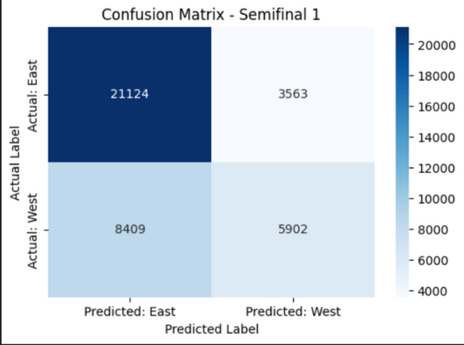
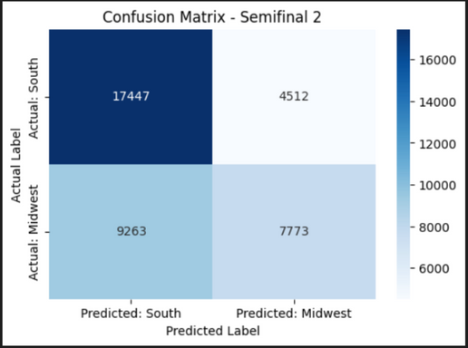
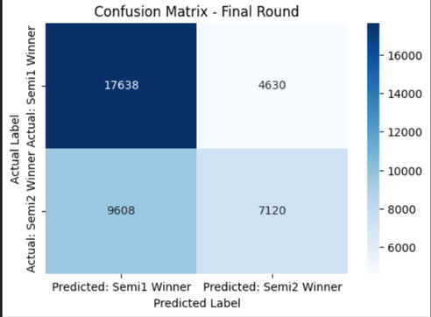
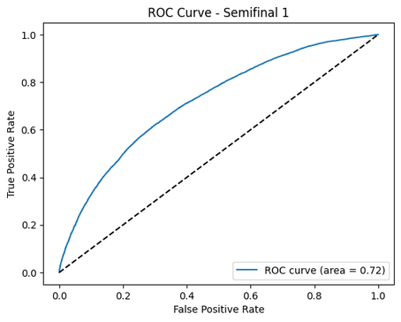
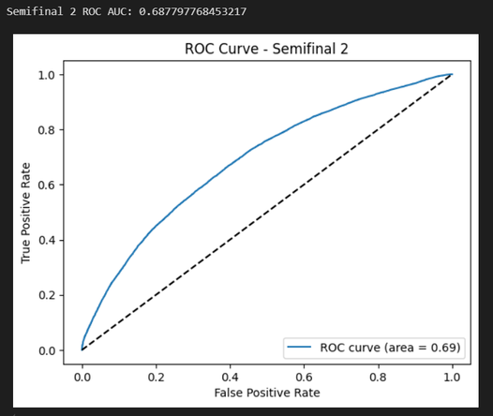
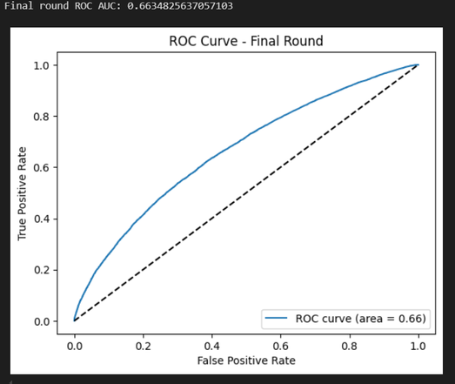
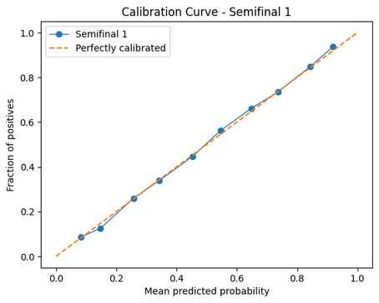
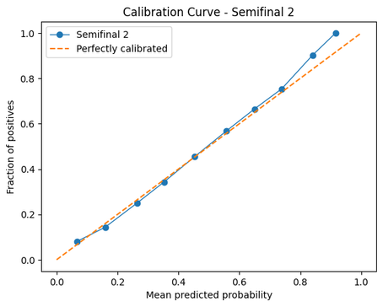
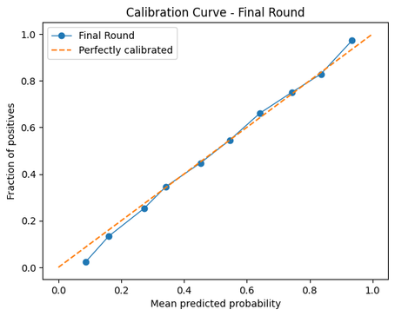
National Champion
Semifinal 1
Semifinal 2

Slide 12
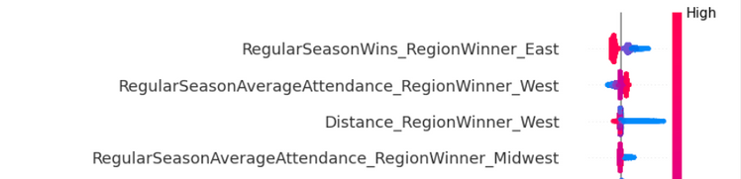
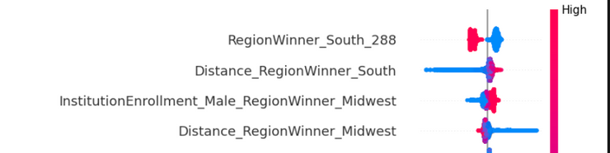
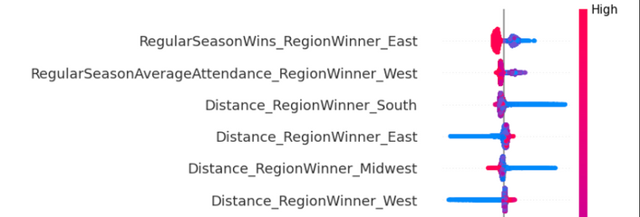
Model Inferences
Semifinal 1
Semifinal 2
National Champion
Regular Season Wins (East) – The Strongest Factor - Huskies
Regular Season Attendance (West) - Proxy for affinity
Distance Between the Fan & the Institution (West) – Regional Bias
Midwest Attendance - Indirect Impact on Fan Predictions
RegionWinner_South_288 – The Biggest Factor - Cougors
Distance Between the Fan & the Institution (South) – Regional Bias
School Size - preference for larger schools.
Distance Between the Fan & the Institution (Midwest) – More Regional Bias
4 out of 6 parameters that affect the final are “distance”
Clear indication of how affinity affects fans predicting the bracket
If the team from semifinal-1 is UCONN, fans choose them as National champions in most cases.

Slide 13
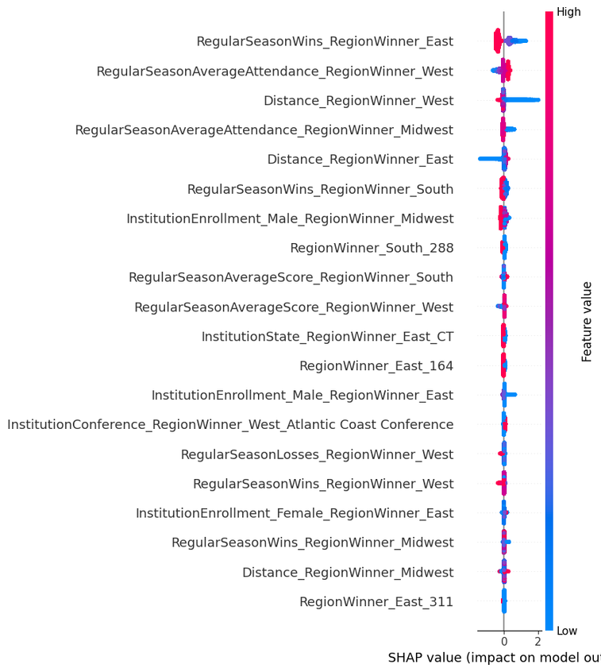
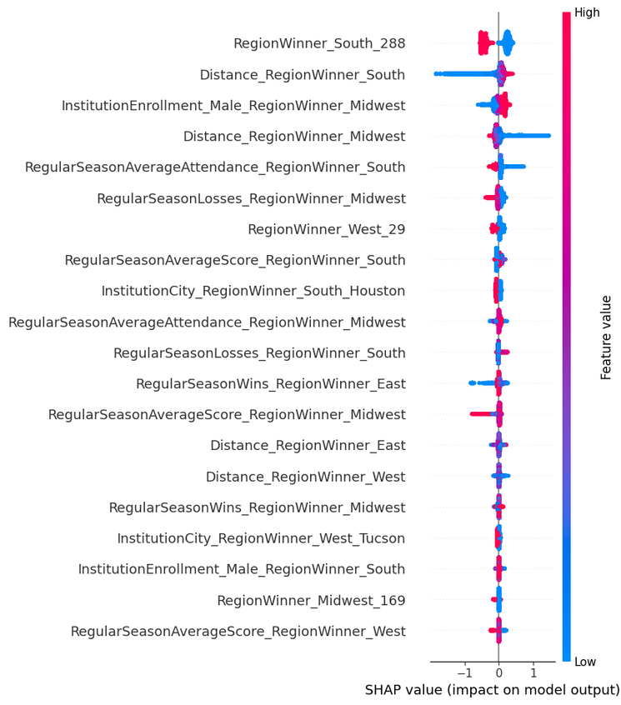
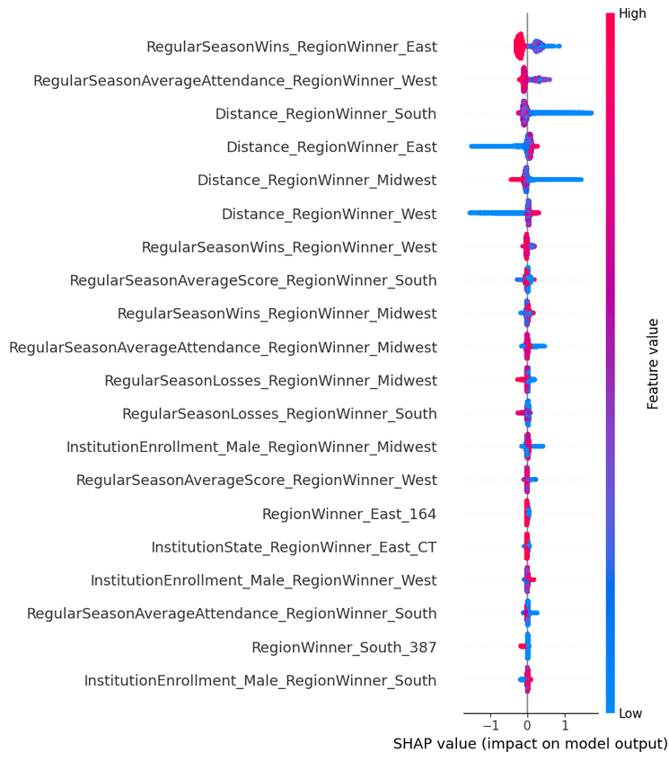
East West Model
South Midwest Model
National Champion Model

Slide 14

What We Recommend
Yes, distance plays a role in affinity, at least for stronger teams. So we recommend they engage and involve fans during home games
Texas has high school affinity and higher fan engagement- which makes it a good place to target investments and other promotional events
Stats play a role!- NCAA can build an interactive or AI-based stats dashboard and tools to increase engagement, as its evident

